Slide 1

Audio Steganography
Silver Oak College of Engineering and Technology Ahmedabad – 382481
Created By:- Internal Guide :- Mr. Richard Sonaliya
110770107030-Manush Desai

Slide 2
What Is Steganography?
Steganography is to hide message in such a way that no one apart from the intended recipient even knows that message has been sent.
Steganography includes the concealment of information within computer files. In digital steganography, electronic communications may include steganography coding inside of a transport layer, such as a document file, image file, program or protocol.
Steganography is the art and science of writing hidden messages in such a way that no one, apart from the sender and intended recipient, suspects the existence of the message.

Slide 3
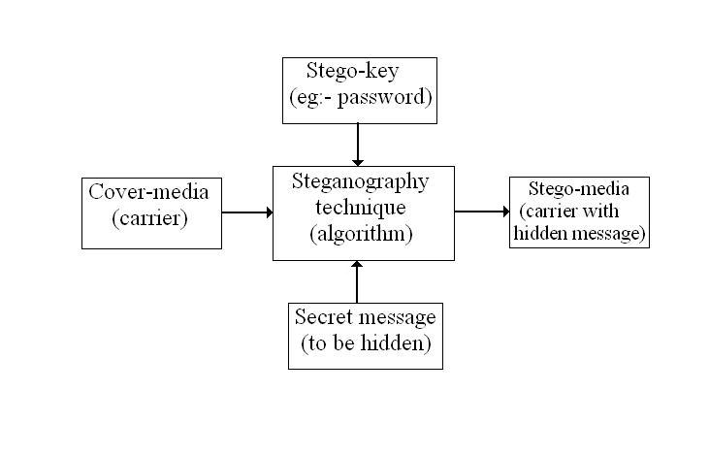
Block Diagram Of Steganography

Slide 4
Introduction To Audio Steganography
Audio Steganography is the scheme of hiding the existence of secret information by concealing it into another medium such as audio file.
Audio Steganography is a technique used to transmit hidden information by modifying an audio signal in an imperceptible manner. It is the science of hiding some secret text or audio information in a host message. The host message before Steganography and Stego message after Steganography have the same characteristics.
Embedding secret messages in digital sound is a more difficult process. Varieties of techniques for embedding information in digital audio have been established.

Slide 5
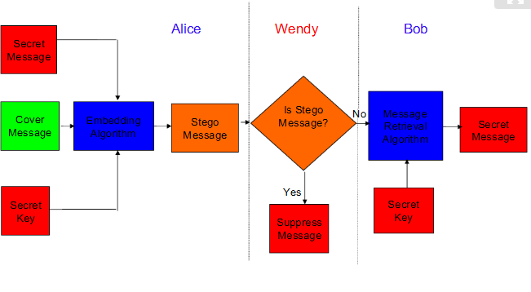
Basic Flow Chart Of Audio Steganography

Slide 6
Methods Of Audio Data Hiding
Least Significant Bit
Spread Spectrum
Discrete Wavelets Transform
Low-Bit Encoding
Phase Coding
Echo Data Hiding

Slide 7
Least Significant Bit
Least significant bit (LSB) coding is the simplest way to embed information in a digital audio file.
By substituting the least significant bit of each sampling point with a binary message.
In implementations of LSB coding, the least significant bits of a sample are replaced with message bits.
To extract a secret message from an LSB encoded sound file, the receiver needs access to the sequence of sample indices used in the embedding process.

Slide 8
Spread Spectrum Technique
Spread Spectrum steganography on audio data will be implemented with the following scheme:
Transform the audio cover object in time-domain into frequency-domain using Fast Fourier Transform.
Adding the information signal by using spread-spectrum to the cover object in frequency-domain.
Transform back the audio cover object from frequency –domain into time –domain using inverse fast Fourier Transform

Slide 9
Discrete Wavelets Transform
Wavelet transform is used to convert a spatial domain into frequency domain. The use of wavelet in audio stenographic model lies in the fact that the wavelet transform clearly separates the high frequency and low frequency information.

Slide 10
Advantages Of Audio Steganography
Audio based Steganography has the potential to conceal more information.
The flexibility of audio steganography is makes it very potentially powerful.
Many attacks that are malicious against image Steganography algorithms (e.g. geometrical distortions, spatial scaling, etc.) cannot be implemented against audio Steganography schemes. Consequently, embedding information into audio seems more secure due to less steganalysis techniques for attacking to audio.

Slide 11
Project Plan
Roles And Responsibilities:-
User must have to select audio file of type .au format.
User have to write text message or secret message for embedding it in audio file.
User must have to select a audio file for encoding message.
User must have to select a stego-audio file for decoding message.
User must have to give key for encryption and for decryption.

Slide 12
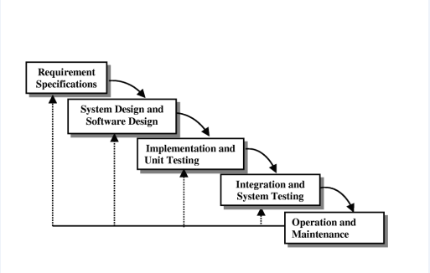
Software Model
Here we use Iterative model.
Iterative process starts with a simple implementation of a subset of the software requirements and iteratively enhances the evolving versions until the full system is implemented.
At each iteration, design modifications are made and new functional capabilities are added. The basic idea behind this method is to develop a system through repeated cycles (iterative) and in smaller portions at a time (incremental).

Slide 13
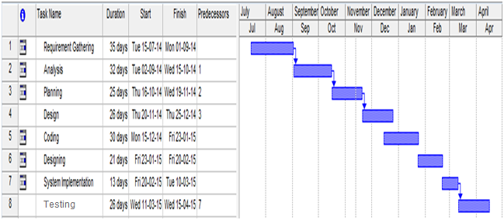
Schedule Representation

Slide 14
Risk Identification & Analysis
1. Technical Risk:
The device failure problem, software failure problem.
2. Non-technical risk:
Users may not be aware of how to use the software.

Slide 15
Cost Analysis
By COCOMO Model :-
Assuming KLOC = 3500
Effort(E) = 2.4*(3500^1.05) = 8.94 person/month
Time(T) = 2.5*(8.94^0.38) = 5.74 months ~ 6.0 months
Person = E/T
= 8.94/5.74 = 1.55 ~ 2.0 persons
Total Cost = 2*6*15,000(rs)
= Rs. 1,80,000

Slide 16
Tools and technology
Programming Language: Java
Front end : Swing, Java
Tools :Net beans IDE 8.1 or Eclipse

Slide 17
UML Diagrams
Use Case diagram
Sequence diagram
Activity diagram
Class diagram
State transition diagram

Slide 18
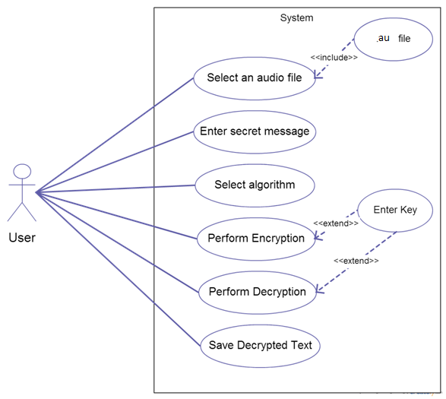
Use Case Diagram

Slide 19
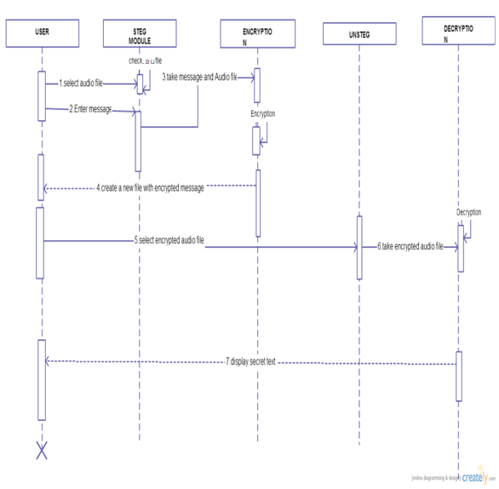
Sequence Diagram

Slide 20
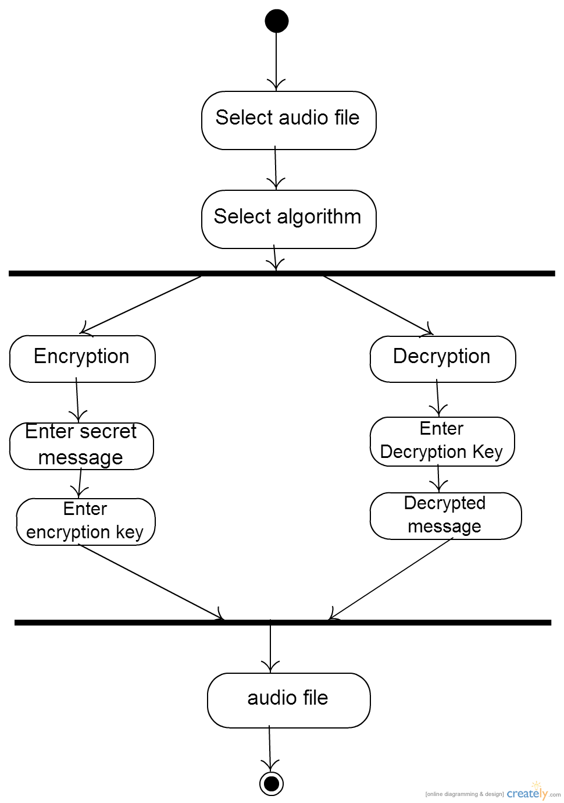
Activity Diagram

Slide 21
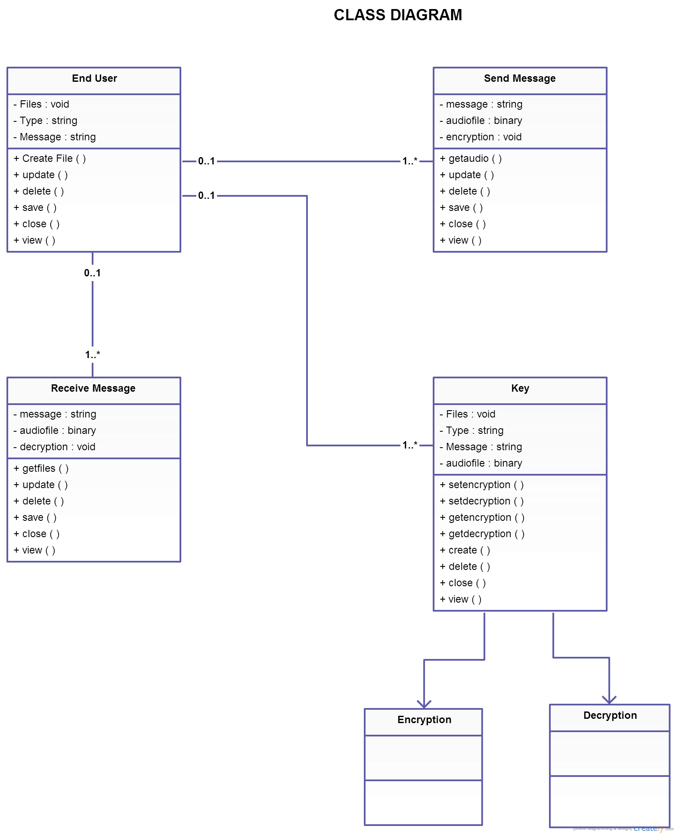
Class Diagram

Slide 22
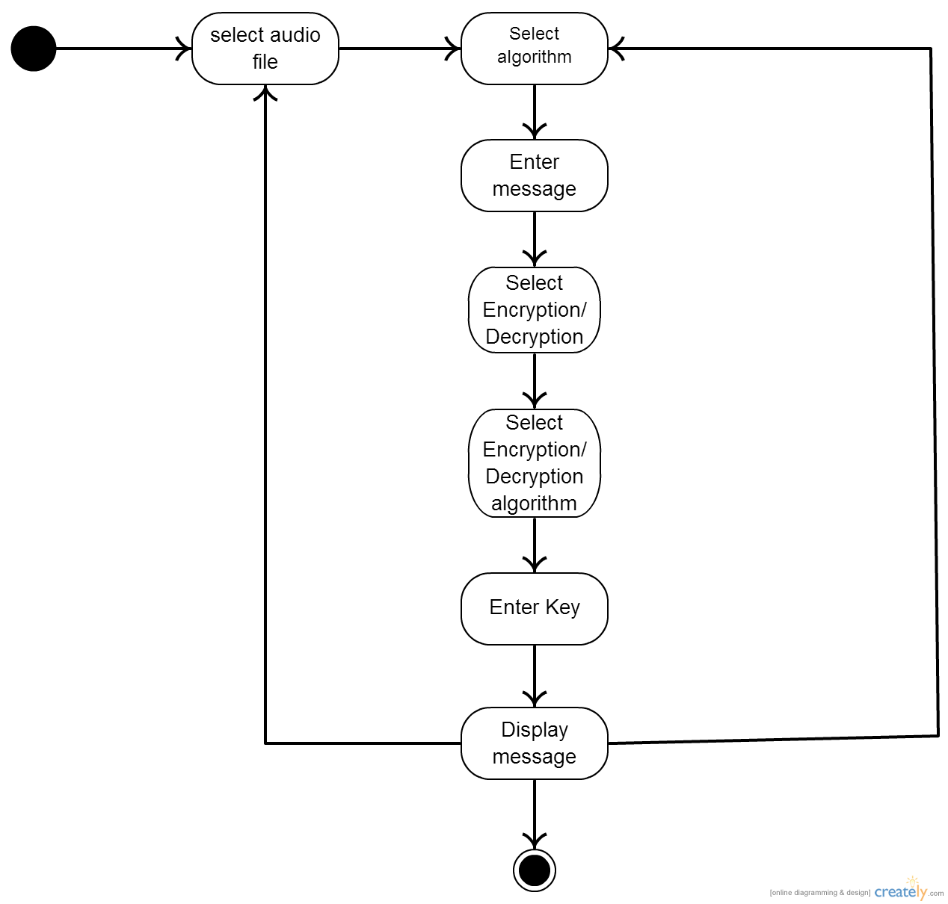
State Diagram

Slide 23
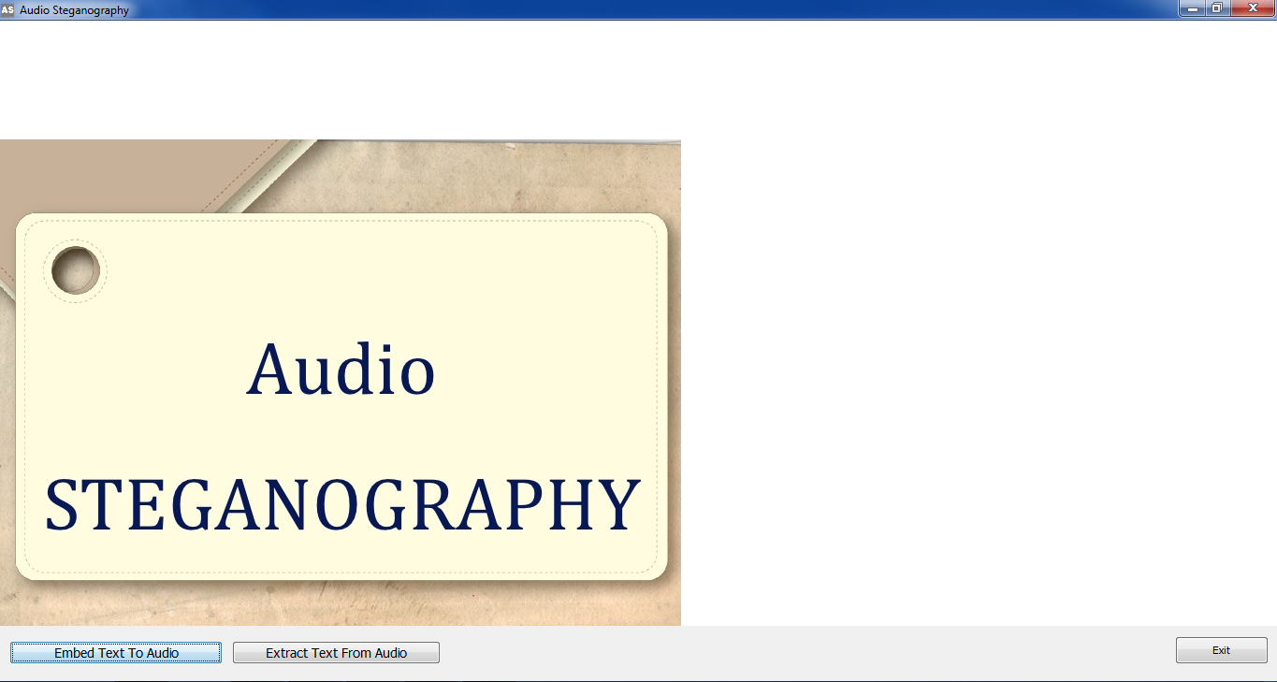
Sample Form

Slide 24
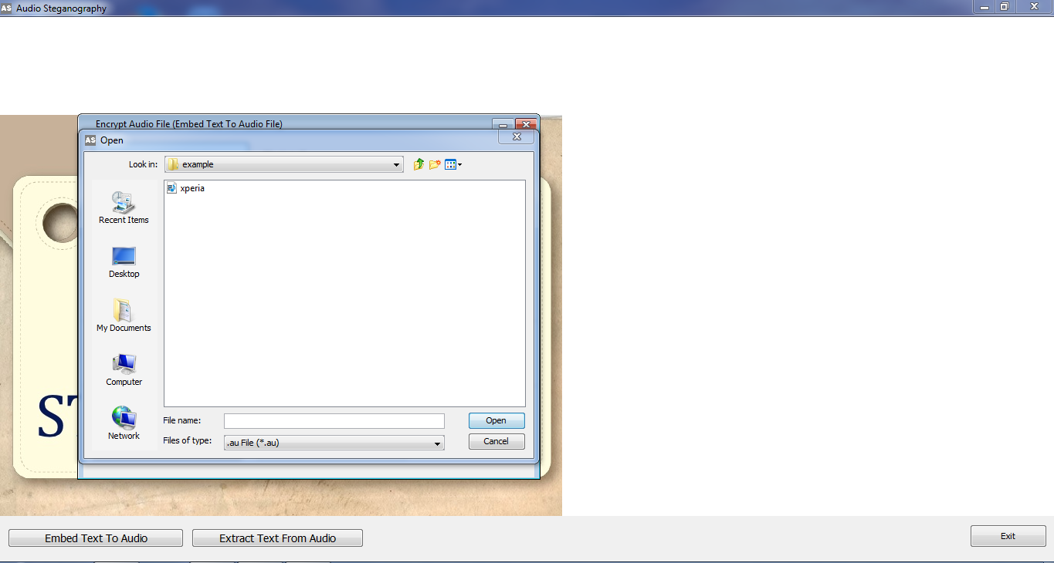
Select Audio file(.AU)

Slide 25
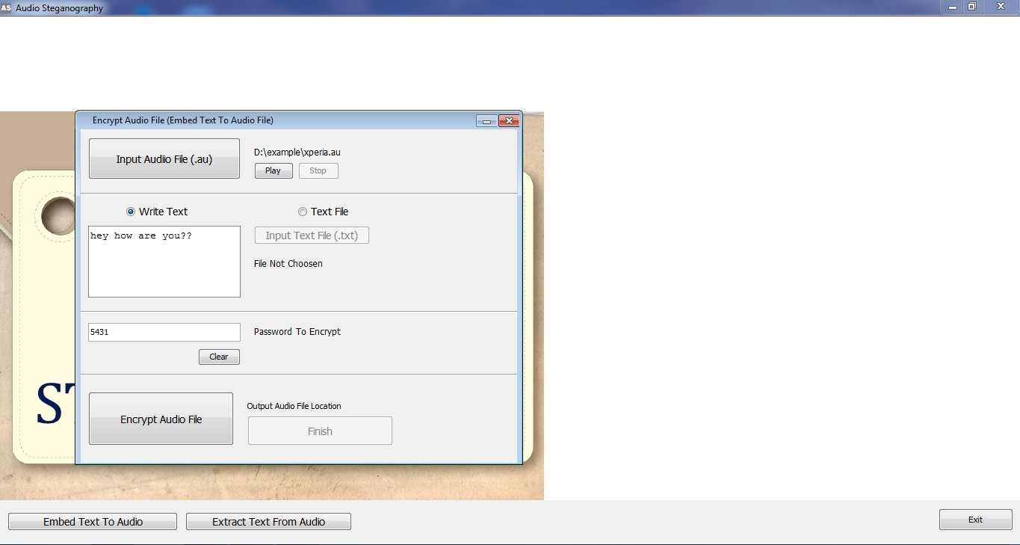
Enter Message

Slide 26
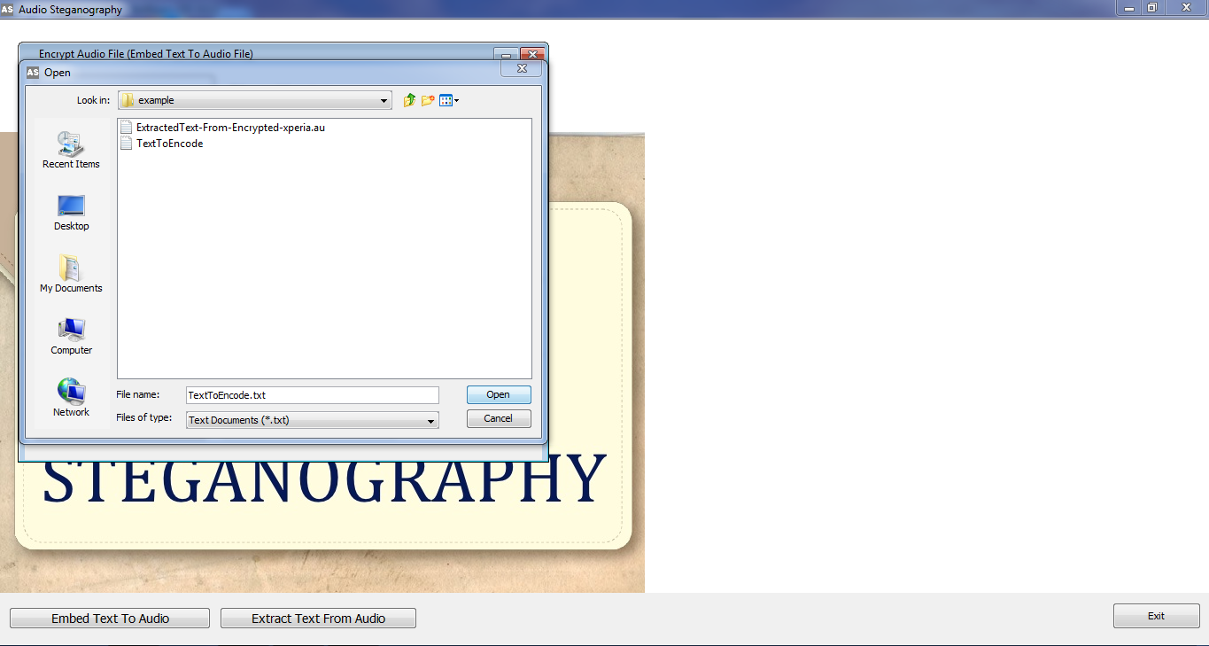
Selecting Text File For Encryption

Slide 27
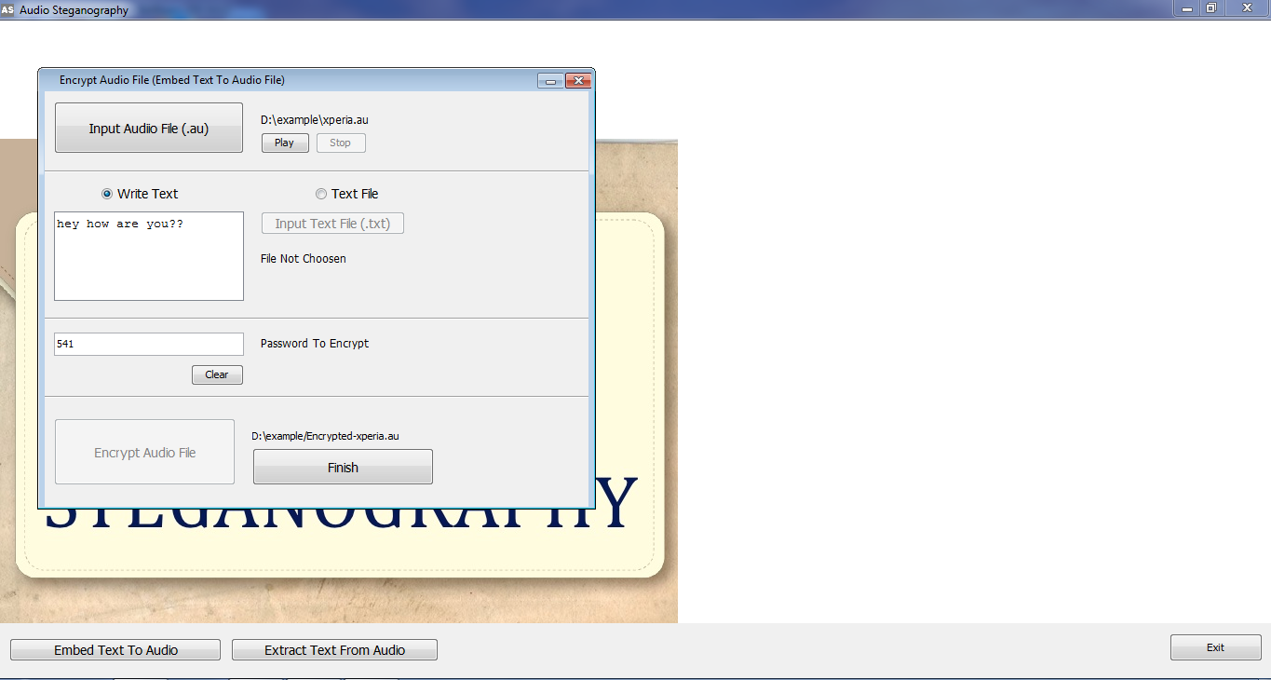
Enter Encryption Key

Slide 28
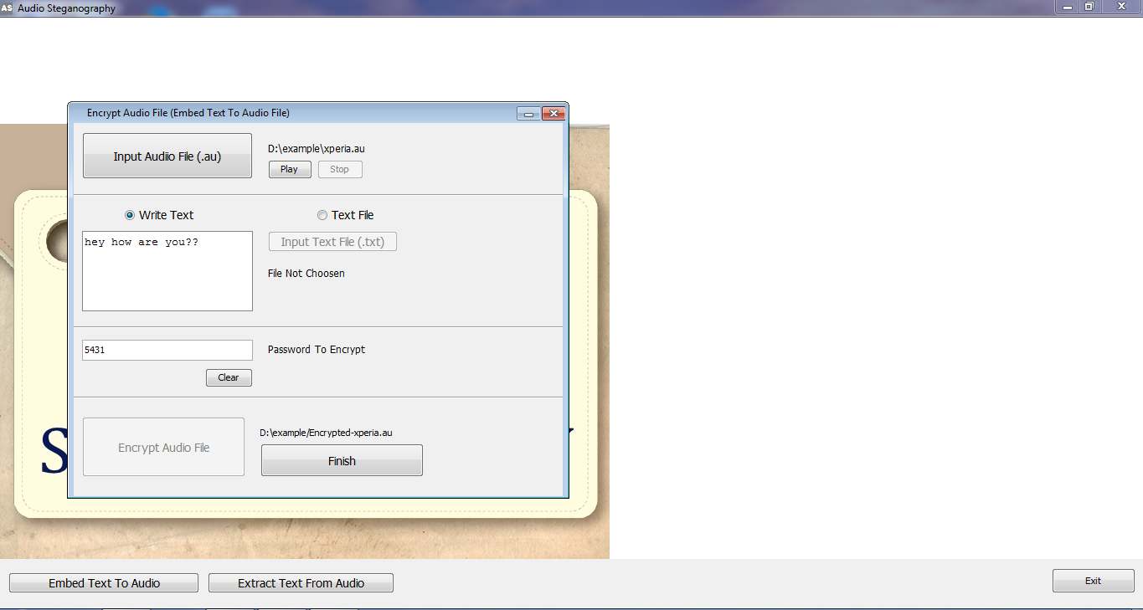
Embedding Done

Slide 29
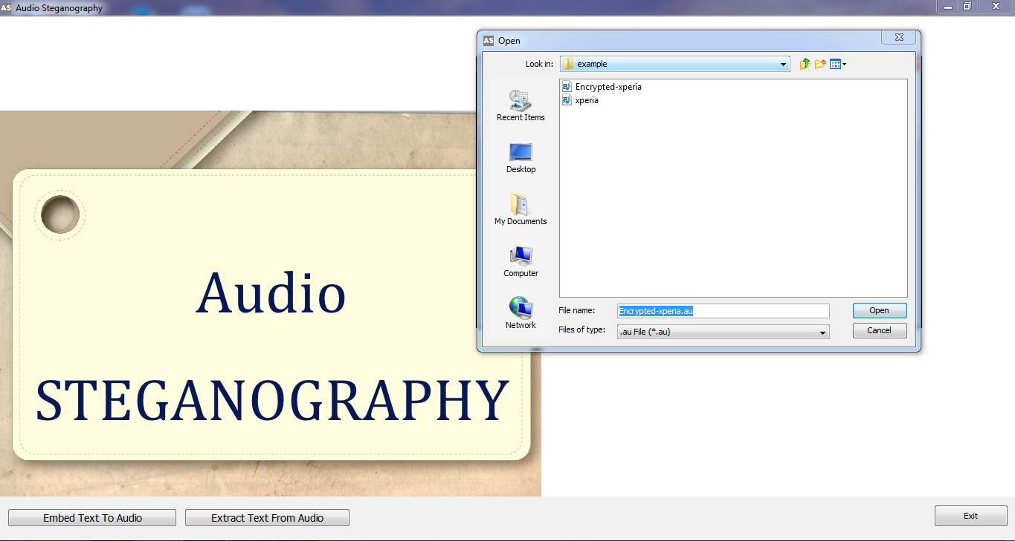
Select Stego-Audio File

Slide 30
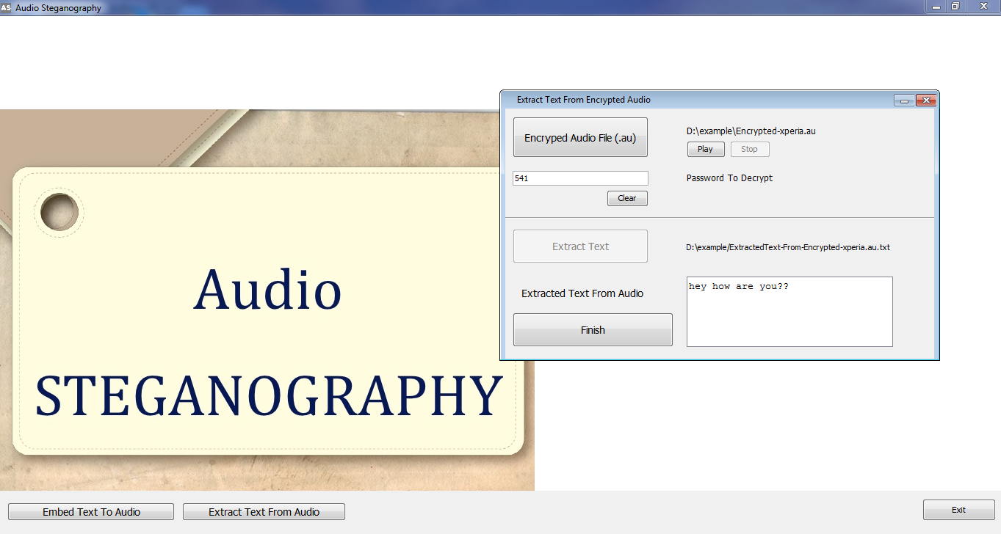
Enter Decryption Key

Slide 31
Displays Message

Slide 32
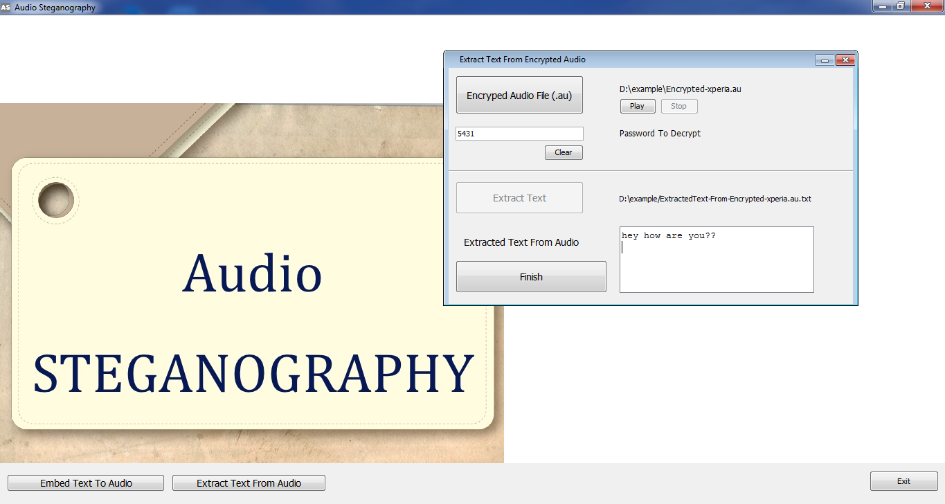
Extraction Done

Slide 33
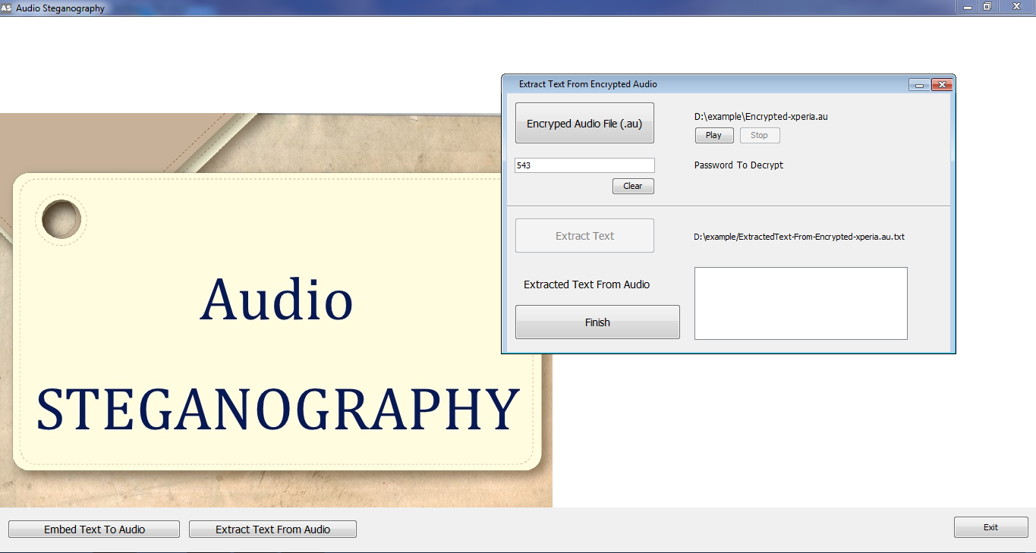
Wrong Decryption Key(Displays Nothing)

Slide 34
Thank you!!
☺

